Slide 1

Shell Scripting

Slide 2
Course Materials
You can access the course materials via this link
https://tinyurl.com/3kaww77s

Slide 3
Day 1 Contents
History
Directory Hierarchy
Redirection & Piping
Processes
sed
AWK

Slide 4
Introduction
The UNIX® operating system was developed originally at AT&T Bell Laboratories in 1969.
It was created as a tool set by programmers for programmers.
The early source code was made available to universities all over the country.

Slide 5
Introduction
Programmers at the University of California at Berkeley made significant modifications to the original source code and called the resulting operating system the Berkeley Software Distribution (BSD) UNIX.
At that time, AT&T's version of the UNIX environment was known as System V.
Notes:
Possibly the most important advance made to the operating system by the programmers at Berkeley was the addition of networking software. This enabled the operating system to function in a local area network (LAN).
Sun -> Solaris
IBM –> AIX
HP -> HP-UX

Slide 6
Unix Essential concepts
Directory Hierarchy
Piping and Redirection
Processes

Slide 7
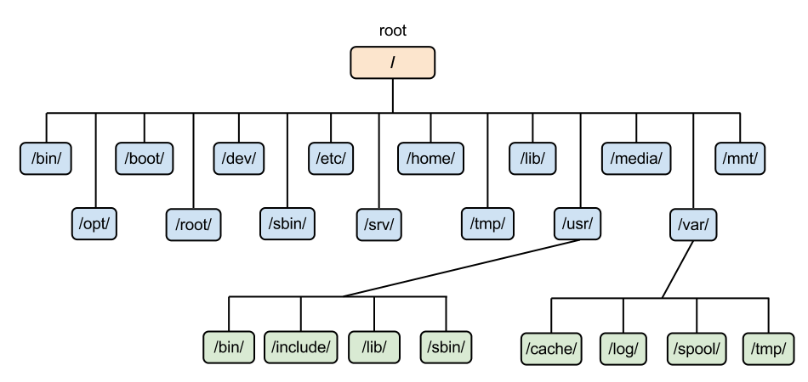
Directory Hierarchy

Slide 8
Directory Hierarchy
pwd
/home/user1/dir1
cd ..
pwd
/home/user1
cd ../..
pwd
/
cd
cd dir1
pwd
/home/user1/dir1
cd ../dir2
pwd
/home/user1/dir2

Slide 9
Directory Hierarchy
To return to home directory
cd
pwd
/home/user1
cd /home/user1
cd ~user1
pwd
/home/user1
cd ~/dir1/d1

Slide 10
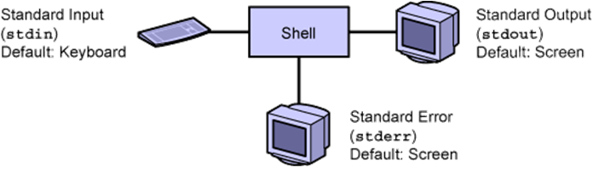
Piping and Redirection
Types of metacharacters
Redirection metacharacters
You can redirect input to and output from commands by using redirection.

Slide 11
Piping and Redirection
Each process that the shell creates, works with file descriptors
File descriptors determine where the input to the command originates and where the output and error messages are sent
0: stdin
1: stdout
2: stderr

Slide 12
Piping and Redirection
Example
cat (Read from stdin) First line (Read from stdin) First line (Write to stdout) What's going on? (Read from stdin) What's going on? (Write to stdout) Control-d (Read from stdin)
The default action of the standard input, standard output, and standard error within the shell can be modified by redirecting stdin, stdout, and stderr.

Slide 13
Piping and Redirection
Redirecting Standard Input
command < filename
Or
command 0< filename
Redirecting Standard Output
command > filename
Or
Command 1> filename
command >> filename
Redirecting Standard Error
command 2>/dev/null
command 1> filename 2>&1

Slide 14
Piping and Redirection
The Pipe character redirect the standard output to the standard input of another command
command | command
Example
who| wc –l
35

Slide 15
Piping and Redirection
ls –F /etc | grep “/”
X11/
acct/
apache/
apache2/
apoc/
head -10 file1 | tail -3 | lp

Slide 16
Piping and Redirection
ls –F /etc | grep “/”
X11/
acct/
apache/
apache2/
apoc/
head -10 file1 | tail -3 | lp

Slide 17
Processes
Every program you run creates a process. For example
Shell
Command
An application
System starts processes called daemons which are processes that run in the background and provide services
Every processes has a PID
When a process creates another, the first is the parent of the new process. The new process is called the child process. Parent waits for her child to finish
Notes:
‹#›

Slide 18
Viewing a Process
Process status command
ps option(s)
Output
PID
TTY -> terminal identifier
Execution time
Command name
Options
-e: all system processes
-f: full information
Notes:
‹#›

Slide 19
Viewing a Process
Example
ps –ef
UID PID PPID C STIME TTY TIME CMD
root 0 0 0 Oct 23 pts/6 0:18 -ksh
root 0 0 0 Oct 23 pts/6 0:30 –ps
Where
C: CPU utilization for scheduling
STIME: Time process started
TIME: Execution time for the process
Notes:
‹#›

Slide 20
Searching for a Specific Process
Using ps and grep commands
ps –e | grep lp
Using pgrep command
pgrep option(s) pattern
pgrep lp
Options
-x: exact match
-u uid: processes for a specific user
-l: display the name with pid
Notes:
‹#›

Slide 21
Sending a Signal to a Process
A signal is a message sent to a process to perform a certain action
Signals are identified by a signal number and a signal name, and has an associated action.
Signal # | Signal Name | Event | Default Response
15 | SIGTERM | Terminate | Exit
9 | SIGKILL | KILL | EXIT
Notes:
‹#›

Slide 22
Sending a Signal to a Process
Using kill command
kill [-signal] PIDs
Examples
pgrep -l mail
215 sendmail
12047 dtmail
kill 12047
pgrep -l mail
215 sendmail
Notes:
‹#›

Slide 23
Sending a Signal to a Process
Using pkill command
pkill [-signal] process_name
Example
pkill -9 dtmail
Notes:
‹#›

Slide 24
Managing a Job
A job is a process that shell can manage
Three types of jobs
Foreground jobs
Background jobs
Stopped jobs
Running a job in the background
Example
sleep 500 &
[1] 3028
[1] + Done
Notes:
‹#›

Slide 25
Managing a Job
Listing Current Jobs
jobs
[1] + Running sleep 500&
Bringing background job into foreground
fg %1
sleep 500
Sending foreground job into background
sleep 500
^Z[1] + Stopped (SIGTSTP) sleep 500
Notes:
‹#›

Slide 26
Managing a Job
jobs
[1] + Stopped (SIGTSTP) sleep 500
bg %1
[1] sleep 500&
jobs
[1] + Running sleep 500
Notes:
‹#›

Slide 27
Managing a Job
Stopping a background job
jobs
[1] + Running sleep 500&
kill –STOP %1
jobs
[1] + Stopped (SIGSTOP) sleep 500&
kill %1
[1] + Terminated sleep 500&
jobs
Notes:
‹#›

Slide 28
Useful Commands
split
split a file into n line chunks
diff
compare two files
line
read the first line
Notes:
‹#›

Slide 29
Examples
$ split -10 /etc/passwd
$ls
xaa xad
xab xae
xac xaf
$ line < /etc/passwd
root:x:0:1:Super-User:/:/sbin/sh
Notes:
‹#›
‹#›
$ cat names
sherine
sherine
root
user
user
$ cat uniq-names
sherine
root
mdesouky

Slide 30
The Streamlined Editor
What is sed?
How sed works
Addressing
Commands
Examples
Notes:
‹#›

Slide 31
What is sed?
It is a streamline, non-interactive editor.
It performs the same kind of tasks as in vi.
It doesn’t change your file unless the output is saved with shell redirection.
Notes:
‹#›

Slide 32
How does sed Work?
The sed editor process a file (input) one line at a time and sends its output to the screen.
The sed stores the line it process in a buffer and once processing is finished the line is sent to the screen (unless command was delete) and the next line is read and the process is repeated until the last line is reached.
Notes:
‹#›

Slide 33
Addressing
Addressing is used to determine which lines to be edited.
The addressing format can be
Number
Regular expression
Both
* Number represents a line number.
Notes:
‹#›
‹#›

Slide 34
Commands
The sed commands tell sed what to do with the line:
Print it
Remove it
Change it
The sed format
sed ‘command’ filename
Notes:
‹#›
‹#›

Slide 35
Examples
To print lines contain the pattern root
$sed ‘/root/p’ myfile
sherine
maha
root
root
user
To suppresses the default behavior of the sed
$sed –n ‘/root/p’ myfile
root
Notes:
‹#›
‹#›

Slide 36
Examples
To print lines from maha to root
$sed –n ‘/maha/,/root/p’ myfile
maha
root
To print lines from 2 to the line that begins with us
$sed –n ‘2,/^us/p’ myfile
maha
root
user
Notes:
‹#›

Slide 37
Examples
To delete the third line
$sed ‘3d’ myfile
sherine
maha
user
To delete the last line
$sed ‘$d’ myfile
sherine
maha
root
Notes:
‹#›
‹#›

Slide 38
Examples
To delete lines from 1 to 3
$sed ‘1,3d’ myfile
user
To delete from line 3 to the end
$sed ‘3,$d’ myfile
sherine
maha
To delete lines containing root pattern
$sed ‘/root/d’ myfile
sherine
maha
user
Notes:
‹#›
‹#›

Slide 39
Examples
To substitute sherine by sbahader
$sed ‘s/sherine/sbahader/g’ myfile
sbahader
maha
root
user
$sed –n ‘s/sherine/sbahader/gp’ myfile
sbahader
Notes:
‹#›
‹#›

Slide 40
Examples
To issue multi command
$sed –e ‘2d’ –e ‘s/sherine/sbahader/g’ myfile
sbahader
root
user
Notes:
‹#›
‹#›

Slide 41
The AWK Utility
What is AWK?
What does AWK stands for?
The awk’s format
Records and Fields
Examples
BEGIN Pattern
END Pattern
Conditional Expressions
Loops
Examples
“?|| N N
Notes:
‹#›
‹#›

Slide 42
What is AWK?
awk is a programming language used for manipulating data and generating reports.
awk scans a file line by line, searching for lines that match a specified pattern performing selected actions
Notes:
‹#›
‹#›

Slide 43
What does AWK stands for?
awk stands for the first initials in the last names of each authors of the language, Alfred Aho, Peter Weinberger, and Brian Kernighan
Notes:
‹#›
‹#›

Slide 44
Awk’s Format
The awk program consists of
awk command
Program instructions enclosed in quotes
Input file or default stdin.
$awk ‘instructions’ inputfile
Notes:
‹#›
‹#›

Slide 45
Records and fields
By default, each line is called a record and terminated with a new line.
Record separators are by default carriage return, stored in a built-in variables ORS and RS.
The $0 variable is the entire record.
The NR variable is the record number.
Notes:
‹#›
‹#›

Slide 46
Records and fields
Each record consists of words called fields which by default separated by white spaces.
NF variables contains the number of fields in a record
$1 first field, $2 second field, $3 third field ….
FS variable holds the input field separator, space/tab is the default.
Notes:
‹#›
‹#›

Slide 47
Examples
To print the first field of the file, but as the default delimiter is white space, you have to specify the delimiter
$awk –F: ‘{print $1}’ /etc/passwd
root
daemon
sherine
…
$awk –F: ‘{print “Logname:”,$1}’ /etc/passwd
Logname:root
Logname:daemon
Logname:sherine
…
Notes:
‹#›
‹#›

Slide 48
Examples
To display the whole file (cat)
$awk ‘{print $0}’ /etc/passwd
root:x:0:1:Super-user:/:/sbin/sh
...
To display the file numbered (cat -n)
$awk ‘{print NR,$0}’ /etc/passwd
1 root:x:0:1:Super-user:/:/sbin/sh
...
To display number of fields (words) in each record (line)
$awk –F: ‘{print $0,NF}’ /etc/passwd
root:x:0:1:Super-user:/:/sbin/sh 7
...
Notes:
‹#›
‹#›

Slide 49
BEGIN Pattern
BEGIN Pattern is followed by an action block that is executed before awk process any line from the input file.
BEGIN action is often used to change the value of the built-in variables, FS, RS, and so forth to assign initial values to user-defined variables and print headers of titles.
Example
$awk ‘BEGIN{FS=“:”; RS=“\n\n”} {print $1,$2,$3}’ myfile
Notes:
‹#›
‹#›

Slide 50
END Pattern
END patterns are handled after all lines of input have been processed.
It does not match any input line
Example:
To print the number of lines in a file
$awk ‘END { print NR } ’ testfile
Notes:
‹#›
‹#›

Slide 51
Conditional expressions
condition expression1 ? expression2 :expression3
if (expression1)
expression2
else
expression3
if (expression1){
statement; statement;...
}
else if (expression2){
statement; statement;...
}
else {
statement
}
condition expression1 ? expression2 :expression3
if (expression1)
expression2
else
expression3
Notes:
‹#›
‹#›

Slide 52
Conditional expressions
condition expression1 ? expression2 :expression3
if (expression1)
expression2
else
expression3
if (expression1){
statement; statement;...
}
else if (expression2){
statement; statement;...
}
else {
statement
}
if (expression1){
statement; statement;...
}
else if (expression2){
statement; statement;...
}
else {
statement
}
Notes:
‹#›
‹#›

Slide 53
Relational Operators
Operator | Meaning
< | Less than
<= | Less than and equal
== | Equal to
!= | Not equal to
>= | Greater than and equal
> | Greater than
~ | Match regular expression
!~ | Not matched by regular expression
Notes:
‹#›
‹#›

Slide 54
Loops
while Loop
$awk –F: ’{i=1; while (i<NF) {print NF,$i;i++}}’ /etc/passwd
For Loop
$awk ‘{for ( i=1 ; i<NF; i++) print NF,$i}’ /etc/passwd
Notes:
‹#›
‹#›
Output
7 root
7 x
7 0
….
Output

Slide 55
Examples (cont.)
The variable max value is set according to compression between the first 2 fields:
$ awk ‘{if ($1>$2)
max=$1;
else
max=$2;
print max}’ testing
Arithmetical Operations
$ awk ‘{if ($1*$2>100) print $0}’ testing
Notes:
‹#›
‹#›

Slide 56
Examples (cont.)
To display line 4 and 5 only
$awk ‘{if (NR==4 || NR==5)
print NR”:”$0
}’ /etc/passwd
Notes:
‹#›
‹#›

Slide 57
SBAHADER@GMAIL.COM
Thanks ☺

